Slide 1
Programming
Massively Parallel Processors
CUDA Programming Model
© David Kirk/NVIDIA and Wen-mei W. Hwu, 2007-2010
ECE 498AL, University of Illinois, Urbana-Champaign

Slide 2
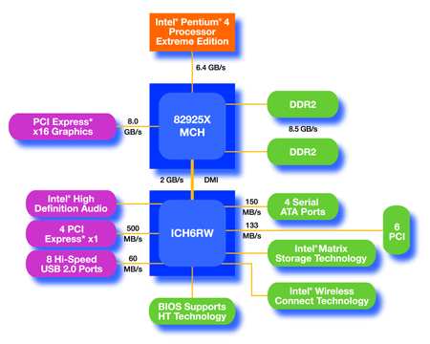
An Example of Physical Reality Behind CUDA
CPU
(host)
GPU w/
local DRAM
(device)
© David Kirk/NVIDIA and Wen-mei W. Hwu, 2007-2010
ECE 498AL, University of Illinois, Urbana-Champaign

Slide 3
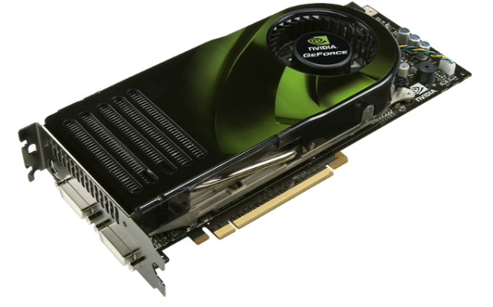
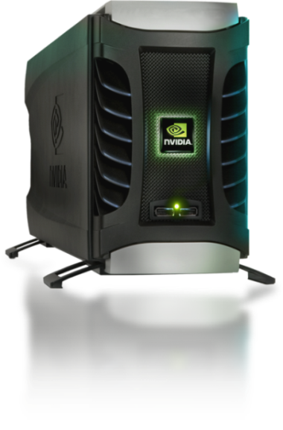
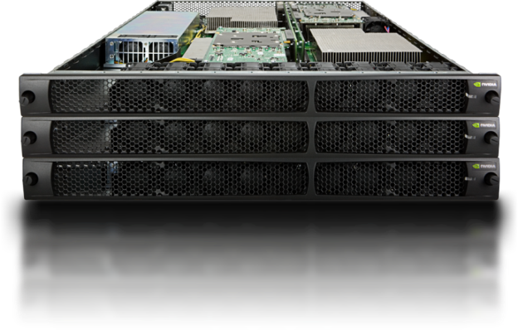
Parallel Computing on a GPU
8-series GPUs deliver 25 to 200+ GFLOPS
on compiled parallel C applications
  Available in laptops, desktops, and clusters
GPU parallelism is doubling every year
Programming model scales transparently
Programmable in C with CUDA tools
Multithreaded SPMD model uses application
data parallelism and thread parallelism
GeForce 8800
Tesla D870
© David Kirk/NVIDIA and Wen-mei W. Hwu, 2007-2010
ECE 498AL, University of Illinois, Urbana-Champaign
Tesla S870

Slide 4
CUDA – C with no shader limitations!
Integrated host+device app C program
  Serial or modestly parallel parts in host C code
  Highly parallel parts in device SPMD kernel C code
Serial Code (host)‏
Parallel Kernel (device)‏
KernelA<<< nBlk, nTid >>>(args);
. . .
Serial Code (host)‏
Parallel Kernel (device)‏
KernelB<<< nBlk, nTid >>>(args);
. . .
© David Kirk/NVIDIA and Wen-mei W. Hwu, 2007-2010
ECE 498AL, University of Illinois, Urbana-Champaign

Slide 5
CUDA Devices and Threads
A compute device
  Is a coprocessor to the CPU or host
  Has its own DRAM (device memory)‏
  Runs many threads in parallel
  Is typically a GPU but can also be another type of parallel processing device
Data-parallel portions of an application are expressed as device kernels which run on many threads
Differences between GPU and CPU threads
  GPU threads are extremely lightweight
    Very little creation overhead
  GPU needs 1000s of threads for full efficiency
    Multi-core CPU needs only a few
© David Kirk/NVIDIA and Wen-mei W. Hwu, 2007-2010
ECE 498AL, University of Illinois, Urbana-Champaign

Slide 6
G80 CUDA mode – A Device Example
Processors execute computing threads
New operating mode/HW interface for computing
Host
Input Assembler
Thread Execution Manager
Parallel Data
Cache
Parallel Data
Cache
Parallel Data
Cache
Parallel Data
Cache
Parallel Data
Cache
Parallel Data
Cache
Parallel Data
Cache
Parallel Data
Cache
Texture
Texture
Texture
Texture
Texture
Texture
Texture
Texture
Texture
Load/store
Load/store
Load/store
Load/store
Load/store
Load/store
Global Memory
© David Kirk/NVIDIA and Wen-mei W. Hwu, 2007-2010
ECE 498AL, University of Illinois, Urbana-Champaign

Slide 7
Extended C
Integrated source
(foo.cu)
cudacc
EDG C/C++ frontend
Open64 Global Optimizer
GPU Assembly
foo.s
CPU Host Code
foo.cpp
OCG
gcc / cl
G80 SASS
foo.sass
Mark Murphy, “NVIDIA’s Experience with Open64,”
www.capsl.udel.edu/conferences/open64/2008/Papers/101.doc
© David Kirk/NVIDIA and Wen-mei W. Hwu, 2007-2010
ECE 498AL, University of Illinois, Urbana-Champaign
Notes:
TBD: Define SASS = SPA Assembly language.
OCG: Optimized Code Generation

Slide 8
Arrays of Parallel Threads
A CUDA kernel is executed by an array of threads
  All threads run the same code (SPMD)‏
  Each thread has an ID that it uses to compute memory addresses and make control decisions
threadID
0
1
2
3
4
5
6
7
…
float x = input[threadID];
float y = func(x);
output[threadID] = y;
…
© David Kirk/NVIDIA and Wen-mei W. Hwu, 2007-2010
ECE 498AL, University of Illinois, Urbana-Champaign

Slide 9
Thread Blocks: Scalable Cooperation
Divide monolithic thread array into multiple blocks
  Threads within a block cooperate via shared memory, atomic operations and barrier synchronization
  Threads in different blocks can cooperate via atomic operations on global memory
Thread Block 0
Thread Block 1
Thread Block N - 1
threadID
0
1
2
3
4
5
6
7
0
1
2
3
4
5
6
7
0
1
2
3
4
5
6
7
…
float x = input[threadID];
float y = func(x);
output[threadID] = y;
…
…
float x = input[threadID];
float y = func(x);
output[threadID] = y;
…
…
float x = input[threadID];
float y = func(x);
output[threadID] = y;
…
…
© David Kirk/NVIDIA and Wen-mei W. Hwu, 2007-2010
ECE 498AL, University of Illinois, Urbana-Champaign

Slide 10
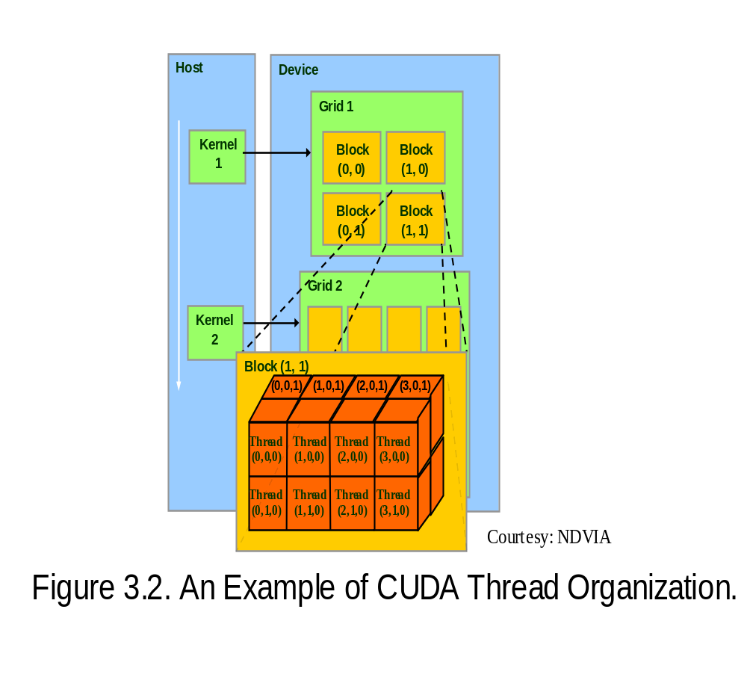
Block IDs and Thread IDs
Each thread uses IDs to decide what data to work on
  Block ID: 1D or 2D
  Thread ID: 1D, 2D, or 3D
Simplifies memory
addressing when processing
multidimensional data
  Image processing
  Solving models on volumes
  …
© David Kirk/NVIDIA and Wen-mei W. Hwu, 2007-2010
ECE 498AL, University of Illinois, Urbana-Champaign

Slide 11
CUDA Memory Model Overview
Global memory
  Main means of communicating R/W Data between host and device
  Contents visible to all threads
  Long latency access
We will focus on global memory for now
  Constant and shared memory will come later
Grid
Block (0, 0)‏
Block (1, 0)‏
Shared Memory
Shared Memory
Registers
Registers
Registers
Registers
Thread (0, 0)‏
Thread (1, 0)‏
Thread (0, 0)‏
Thread (1, 0)‏
Host
Global Memory
© David Kirk/NVIDIA and Wen-mei W. Hwu, 2007-2010
ECE 498AL, University of Illinois, Urbana-Champaign

Slide 12
CUDA API Highlights:
Easy and Lightweight
The API is an extension to the ANSI C programming language
Low learning curve
The hardware is designed to enable lightweight runtime and driver
High performance
© David Kirk/NVIDIA and Wen-mei W. Hwu, 2007-2010
ECE 498AL, University of Illinois, Urbana-Champaign

Slide 13
CUDA Device Memory Allocation
cudaMalloc()
  Allocates object in the device Global Memory
  Requires two parameters
    Address of a pointer to the allocated object
    Size of of allocated object
cudaFree()
  Frees object from device Global Memory
    Pointer to freed object
Grid
Block (0, 0)‏
Block (1, 0)‏
Shared Memory
Shared Memory
Registers
Registers
Registers
Registers
Thread (0, 0)‏
Thread (1, 0)‏
Thread (0, 0)‏
Thread (1, 0)‏
Host
Global
Memory
© David Kirk/NVIDIA and Wen-mei W. Hwu, 2007-2010
ECE 498AL, University of Illinois, Urbana-Champaign

Slide 14
CUDA Device Memory Allocation (cont.)‏
Code example:
  Allocate a 64 * 64 single precision float array
  Attach the allocated storage to Md
  “d” is often used to indicate a device data structure
TILE_WIDTH = 64;
Float* Md
int size = TILE_WIDTH * TILE_WIDTH * sizeof(float);
cudaMalloc((void**)&Md, size);
cudaFree(Md);
© David Kirk/NVIDIA and Wen-mei W. Hwu, 2007-2010
ECE 498AL, University of Illinois, Urbana-Champaign

Slide 15
CUDA Host-Device Data Transfer
cudaMemcpy()‏
  memory data transfer
  Requires four parameters
    Pointer to destination
    Pointer to source
    Number of bytes copied
    Type of transfer
      Host to Host
      Host to Device
      Device to Host
      Device to Device
Asynchronous transfer
Grid
Block (0, 0)‏
Block (1, 0)‏
Shared Memory
Shared Memory
Registers
Registers
Registers
Registers
Thread (0, 0)‏
Thread (1, 0)‏
Thread (0, 0)‏
Thread (1, 0)‏
Host
Global
Memory
© David Kirk/NVIDIA and Wen-mei W. Hwu, 2007-2010
ECE 498AL, University of Illinois, Urbana-Champaign

Slide 16
CUDA Host-Device Data Transfer
(cont.)
Code example:
  Transfer a 64 * 64 single precision float array
  M is in host memory and Md is in device memory
  cudaMemcpyHostToDevice and cudaMemcpyDeviceToHost are symbolic constants
cudaMemcpy(Md, M, size, cudaMemcpyHostToDevice);
cudaMemcpy(M, Md, size, cudaMemcpyDeviceToHost);
© David Kirk/NVIDIA and Wen-mei W. Hwu, 2007-2010
ECE 498AL, University of Illinois, Urbana-Champaign

Slide 17
CUDA Keywords
© David Kirk/NVIDIA and Wen-mei W. Hwu, 2007-2010
ECE 498AL, University of Illinois, Urbana-Champaign

Slide 18
CUDA Function Declarations
Executed on the:
Only callable from the:
__device__ float DeviceFunc()
device
device
__global__ void KernelFunc()
device
host
__host__ float HostFunc()
host
host
__global__ defines a kernel function
  Must return void
__device__ and __host__ can be used together (for functions that may be used both in the host and in the device)
© David Kirk/NVIDIA and Wen-mei W. Hwu, 2007-2010
ECE 498AL, University of Illinois, Urbana-Champaign

Slide 19
CUDA Function Declarations (cont.)‏
__device__ functions cannot have their address taken
For functions executed on the device:
  No recursion
  No static variable declarations inside the function
  No variable number of arguments
© David Kirk/NVIDIA and Wen-mei W. Hwu, 2007-2010
ECE 498AL, University of Illinois, Urbana-Champaign

Slide 20
Calling a Kernel Function – Thread Creation
A kernel function must be called with an execution configuration:
__global__ void KernelFunc(...);
dim3 DimGrid(100, 50); // 5000 thread blocks
dim3 DimBlock(4, 8, 8); // 256 threads per block
size_t SharedMemBytes = 64; // 64 bytes of shared memory
KernelFunc<<< DimGrid, DimBlock, SharedMemBytes >>>(...);
Any call to a kernel function is asynchronous from CUDA 1.0 on, explicit synch needed for blocking
© David Kirk/NVIDIA and Wen-mei W. Hwu, 2007-2010
ECE 498AL, University of Illinois, Urbana-Champaign

Slide 21
A Simple Running Example
Matrix Multiplication
A simple matrix multiplication example that illustrates the basic features of memory and thread management in CUDA programs
  Leave shared memory usage until later
  Local, register usage
  Thread ID usage
  Memory data transfer API between host and device
  Assume square matrix for simplicity
© David Kirk/NVIDIA and Wen-mei W. Hwu, 2007-2010
ECE 498AL, University of Illinois, Urbana-Champaign

Slide 22
Programming Model:
Square Matrix Multiplication Example
P = M * N of size WIDTH x WIDTH
Without tiling:
  One thread calculates one element of P
  M and N are loaded WIDTH times from global memory
N
WIDTH
M
P
WIDTH
WIDTH
WIDTH
© David Kirk/NVIDIA and Wen-mei W. Hwu, 2007-2010
ECE 498AL, University of Illinois, Urbana-Champaign

Slide 23
Memory Layout of a Matrix in C
M_{0,0}
M_{1,0}
M_{2,0}
M_{3,0}
M_{0,1}
M_{1,1}
M_{2,1}
M_{3,1}
M_{0,2}
M_{1,2}
M_{2,2}
M_{3,2}
M_{0,3}
M_{1,3}
M_{2,3}
M_{3,3}
M
M_{0,0}
M_{1,0}
M_{2,0}
M_{3,0}
M_{0,1}
M_{1,1}
M_{2,1}
M_{3,1}
M_{0,2}
M_{1,2}
M_{2,2}
M_{3,2}
M_{0,3}
M_{1,3}
M_{2,3}
M_{3,3}
© David Kirk/NVIDIA and Wen-mei W. Hwu, 2007-2010
ECE 498AL, University of Illinois, Urbana-Champaign

Slide 24
Step 1: Matrix Multiplication
A Simple Host Version in C
// Matrix multiplication on the (CPU) host in double precision
void MatrixMulOnHost(float* M, float* N, float* P, int Width)‏
{
for (int i = 0; i < Width; ++i)‏
for (int j = 0; j < Width; ++j) {
double sum = 0;
for (int k = 0; k < Width; ++k) {
double a = M[i * width + k];
double b = N[k * width + j];
sum += a * b;
}
P[i * Width + j] = sum;
}
}
N
k
j
WIDTH
M
P
i
WIDTH
k
© David Kirk/NVIDIA and Wen-mei W. Hwu, 2007-2010
ECE 498AL, University of Illinois, Urbana-Champaign
WIDTH
WIDTH

Slide 25
Step 2: Input Matrix Data Transfer
(Host-side Code)‏
void MatrixMulOnDevice(float* M, float* N, float* P, int Width)‏
{
int size = Width * Width * sizeof(float);
float *Md, *Nd, *Pd;
…
1. // Allocate and Load M, N to device memory
cudaMalloc(&Md, size);
cudaMemcpy(Md, M, size, cudaMemcpyHostToDevice);
cudaMalloc(&Nd, size);
cudaMemcpy(Nd, N, size, cudaMemcpyHostToDevice);
// Allocate P on the device
cudaMalloc(&Pd, size);
© David Kirk/NVIDIA and Wen-mei W. Hwu, 2007-2010
ECE 498AL, University of Illinois, Urbana-Champaign

Slide 26
Step 3: Output Matrix Data Transfer
(Host-side Code)‏
2. // Kernel invocation code – to be shown later
…
3. // Read P from the device
cudaMemcpy(P, Pd, size, cudaMemcpyDeviceToHost);
// Free device matrices
cudaFree(Md); cudaFree(Nd); cudaFree (Pd);
}
© David Kirk/NVIDIA and Wen-mei W. Hwu, 2007-2010
ECE 498AL, University of Illinois, Urbana-Champaign

Slide 27
Step 4: Kernel Function
// Matrix multiplication kernel – per thread code
__global__ void MatrixMulKernel(float* Md, float* Nd, float* Pd, int Width)‏
{
// Pvalue is used to store the element of the matrix
// that is computed by the thread
float Pvalue = 0;
© David Kirk/NVIDIA and Wen-mei W. Hwu, 2007-2010
ECE 498AL, University of Illinois, Urbana-Champaign

Slide 28
Step 4: Kernel Function (cont.)‏
for (int k = 0; k < Width; ++k)‏ {
float Melement = Md[threadIdx.y*Width+k];
float Nelement = Nd[k*Width+threadIdx.x];
Pvalue += Melement * Nelement;
}
Pd[threadIdx.y*Width+threadIdx.x] = Pvalue;
}
Nd
k
tx
WIDTH
Md
Pd
ty
ty
WIDTH
k
tx
© David Kirk/NVIDIA and Wen-mei W. Hwu, 2007-2010
ECE 498AL, University of Illinois, Urbana-Champaign
WIDTH
WIDTH
Notes:
This should be emphasized! Maybe another slide on “This is the first thing”

Slide 29
Step 5: Kernel Invocation
(Host-side Code)
// Setup the execution configuration
dim3 dimGrid(1, 1);
dim3 dimBlock(Width, Width);
// Launch the device computation threads!
MatrixMulKernel<<<dimGrid, dimBlock>>>(Md, Nd, Pd, Width);
© David Kirk/NVIDIA and Wen-mei W. Hwu, 2007-2010
ECE 498AL, University of Illinois, Urbana-Champaign

Slide 30







Only One Thread Block Used
Nd
One Block of threads compute matrix Pd
  Each thread computes one element of Pd
Each thread
  Loads a row of matrix Md
  Loads a column of matrix Nd
  Perform one multiply and addition for each pair of Md and Nd elements
  Compute to off-chip memory access ratio close to 1:1 (not very high)‏
Size of matrix limited by the number of threads allowed in a thread block (512 in the 8800)
Grid 1
Block 1
Thread
(2, 2)‏
48
WIDTH
Md
Pd
© David Kirk/NVIDIA and Wen-mei W. Hwu, 2007-2010
ECE 498AL, University of Illinois, Urbana-Champaign

Slide 31
Step 7: Handling Arbitrary Sized Square Matrices (will cover later)
Have each 2D thread block to compute a (TILE_WIDTH)² sub-matrix (tile) of the result matrix
  Each has (TILE_WIDTH)² threads
Generate a 2D Grid of (WIDTH/TILE_WIDTH)² blocks
Nd
WIDTH
Md
Pd
You still need to put a loop around the kernel call for cases where WIDTH/TILE_WIDTH is greater than max grid size (64K)!
by
TILE_WIDTH
ty
WIDTH
bx
tx
© David Kirk/NVIDIA and Wen-mei W. Hwu, 2007-2010
ECE 498AL, University of Illinois, Urbana-Champaign
WIDTH
WIDTH

Slide 32
Some Useful Information on Tools
© David Kirk/NVIDIA and Wen-mei W. Hwu, 2007-2010
ECE 498AL, University of Illinois, Urbana-Champaign
Notes:
Try to update tool slides with the tutorial?

Slide 33
Compilation
Any source file containing CUDA language extensions must be compiled with NVCC
NVCC is a compiler driver
  Works by invoking all the necessary tools and compilers like cudacc, g++, cl, ...
NVCC outputs:
  C code (host CPU Code)
    Must then be compiled with the rest of the application using another tool
  PTX
    Object code directly
    Or, PTX source, interpreted at runtime
© David Kirk/NVIDIA and Wen-mei W. Hwu, 2007-2010
ECE 498AL, University of Illinois, Urbana-Champaign

Slide 34
Linking
Any executable with CUDA code requires two dynamic libraries:
  The CUDA runtime library (cudart)‏
  The CUDA core library (cuda)‏
© David Kirk/NVIDIA and Wen-mei W. Hwu, 2007-2010
ECE 498AL, University of Illinois, Urbana-Champaign

Slide 35
Floating Point
Results of floating-point computations will slightly differ because of:
  Different compiler outputs, instruction sets
  Use of extended precision for intermediate results
    There are various options to force strict single precision on the host
© David Kirk/NVIDIA and Wen-mei W. Hwu, 2007-2010
ECE 498AL, University of Illinois, Urbana-Champaign

Slide 36
Trabalho 1
Implementar a multiplicação de matrizes ladrilhada sequencialmente e em paralelo usando CUDA e OpenMP em precisão simples (float) e dupla (double)
A multiplicação deve ser executada em diferentes configurações:
  1 vez apenas
  100 vezes (oportunidade para usar OpenMP)
  1000 vezes (oportunidade para usar OpenMP)
Ajustar o tamanho das matrizes e do ladrilho para máximo desempenho paralelo e comparar com o desempenho sequencial (média de 3 rodadas)
  Apresentar gráficos com os resultados
© David Kirk/NVIDIA and Wen-mei W. Hwu, 2007-2010
ECE 498AL, University of Illinois, Urbana-Champaign

Slide 37
Trabalho 1
Colocar trabalho no github e incluir um relatório com no mínimo 2 páginas em formato IEEE coluna dupla (http://ras.papercept.net/conferences/support/word.php) com:
  Resumo
  Introdução
  Metodologia
  Resultados
O trabalho pode ser feito individualmente ou em dupla
Entregar até 31/10/2016 (enviar link para a página no github para o email: sp1@lcad.inf.ufes.br sob o assunto: Trabalho 1)
© David Kirk/NVIDIA and Wen-mei W. Hwu, 2007-2010
ECE 498AL, University of Illinois, Urbana-Champaign

